Slide 1

IEEE Collabratec Overview

Slide 2
Overview
Please go to the tool kit for all communication and branding details specific to your needs.
If you are seeking to write copy that is not already provided please utilize this document and the benefits sheet within the tool kit to assist.
If you need further assistance, please contact the Communications Department at:
  corporate-communications@ieee.org

Slide 3
What is IEEE Collabratec?

Slide 4

What is IEEE Collabratec?
IEEE Collabratec is IEEE’s global technical community that seeks to inspire, motivate and recognize those who want to make a difference in their profession.
IEEE Collabratec allows both IEEE Members and non-members to discover, connect, and collaborate with one another to achieve higher goals and move industry knowledge forward.

Slide 5

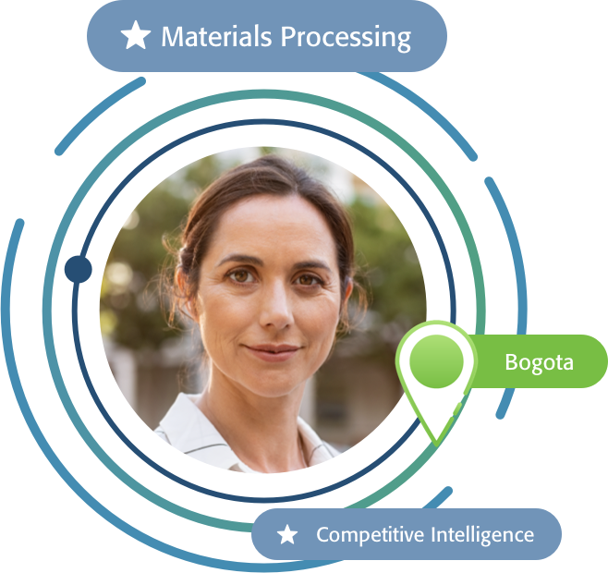
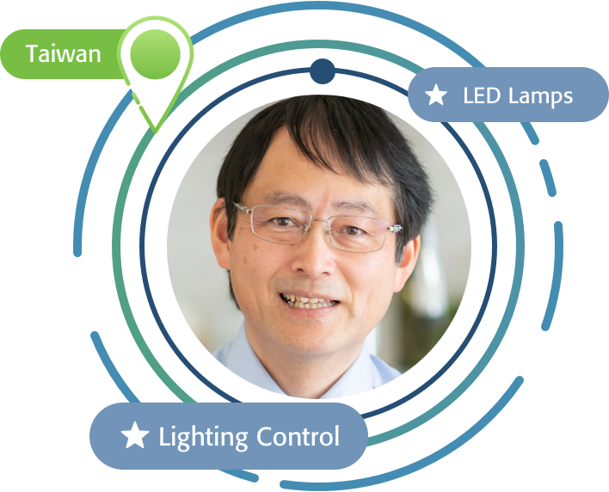
Why Use IEEE Collabratec?
IEEE Collabratec is centered around conversations that are meaningful and productive. With Collabratec, you have support, inspiration, feedback, and a network you can rely on.
Advancing My Career
Networking with People All Over the World
Sharing Insights
Inspires Me
“It’s helping me build the knowledge I need in order to advance in my career.”
“I’ve been able to network with people all over the world.”
“Being able to share insights with others like me is very inspiring.”
View video:
https://youtu.be/Jy1vrITil3o
5

Slide 6
IEEE Collabratec at a Glance
The only platform that unites the IEEE global technical community
Non-Members are welcome, IEEE Members having exclusive / premium services
Network of about 255,000 - including 77,000 IEEE Members
Badging opportunities to recognize Members for their participation and contributions
What can I do on IEEE Collabratec?
Locate and connect w/subject matter experts throughout IEEE
Stay informed about IEEE activities
Join and participate in communities
Organize teams around technical projects with workspaces
Collaborate on papers for publishing
Earn badges and recognition

Slide 7
Competitive Differentiation
Capabilities | LinkedIn | Facebook | Slack | Collabratec
Sizable audience to develop and participate in puzzles/brain teasers
Established communities/groups for puzzle and brain-teaser enthusiasts
Email digests, w/personalized settings (real-time, daily, weekly)
Communities, Workspaces, activities integrated with IEEE Data Store
Micro-Credentialing/badge recognition achievements for puzzle achievement
Analytics for community participants and badge recipients aligned with IEEE affiliations (member grade status, Section, Region, Society, etc.)
Non-Member, community participants flow into IEEE membership development pipeline and outreaches

Slide 8
Audiences

Slide 9
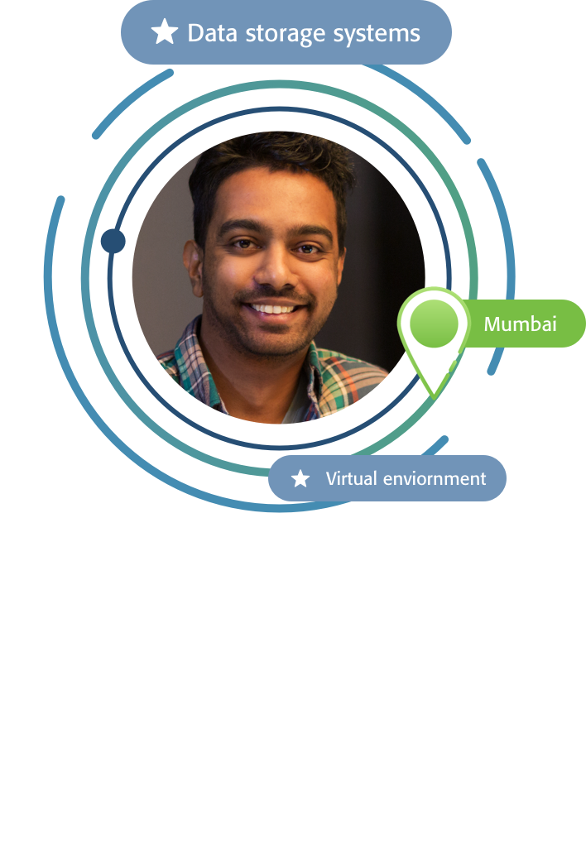
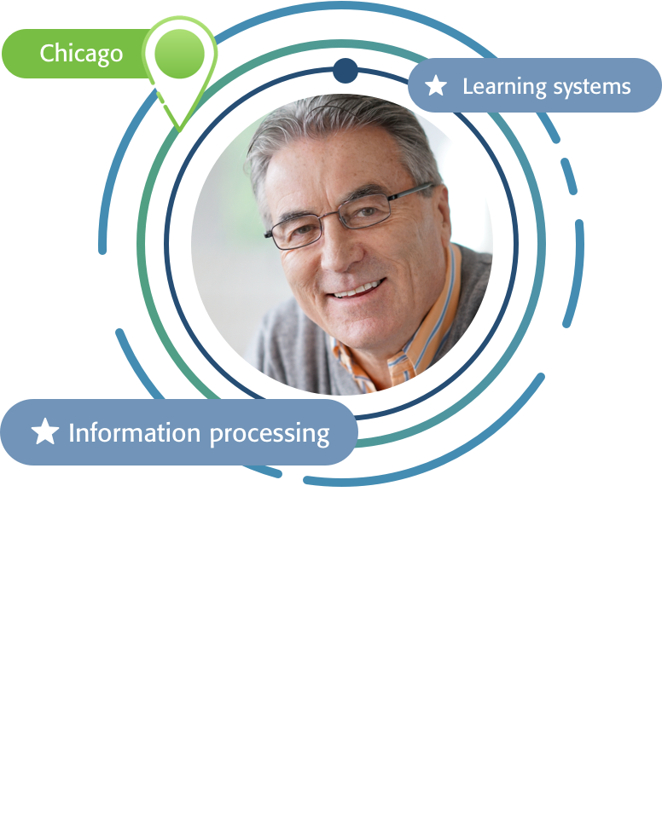
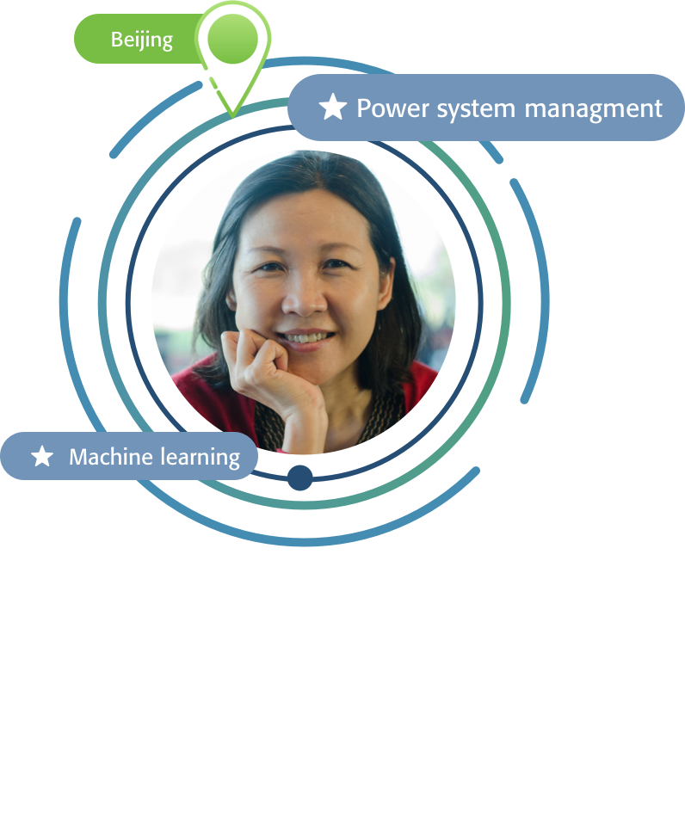
Collabratec's Audiences
  Members
  Authors/Researchers
  Volunteers
  Society Members
  Greater Technical Community
    Academia
    Corporate/Professional
    Students

Slide 10
Features and Benefits

Slide 11



Communities
Communities are places for like-minded professionals to ask questions, share expertise, or debate hot topics as well as discover conferences or meetings taking place around the globe or in a town nearby.
Connect and collaborate with peers; have meaningful discussions
Discover community topics that interest you
TECHNICAL
GEOGRAPHIC
SPECIAL INTERESTS
Stay up-to-date with the latest technical topics including 5G, Smart Cities, Internet of Things, Entrepreneurship, and more.
Discover and share what is happening locally by joining a community focused on your city or region with communities ranging from Asia/Pacific to London to Uganda and more.
Celebrate IEEE's diversity by joining communities for Young Professionals, IEEE Day, Global Student Exchange, Women in Leadership, and more.

Slide 12
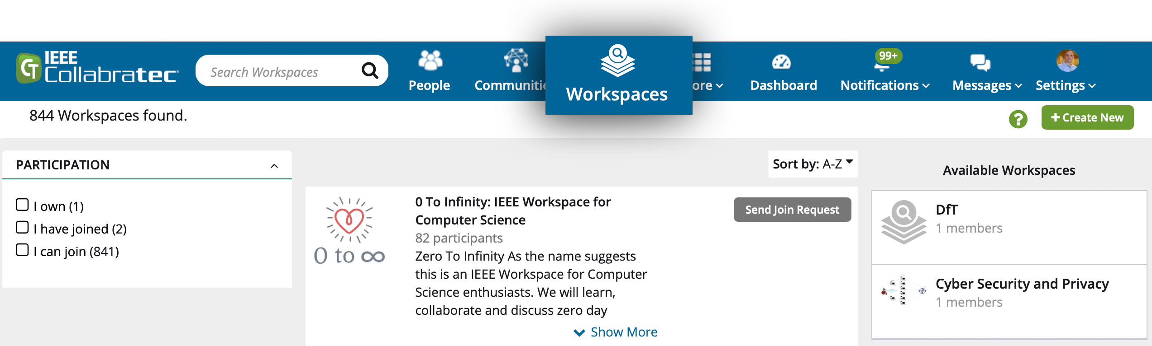
Workspaces
Registered users can create and participate in a workspace.
Workspace participants can collaborate on articles, technical papers, conference presentations, and more.
Workspaces allow you to have private discussions, manage projects, and collaborate on content.
Workspace owners have full control over participants, information, and roles.

Slide 13
Research
Gain full text access to the world's highest quality technical literature in engineering and technology with the IEEE Xplore Digital Library. Filter to hone in on relevant articles, and easily add the metadata record to your Library.

Slide 14
Authors
Imagine an integrated online community designed around the specialized needs of researchers, authors, and other technology professionals.
Authors on IEEE Collabratec enjoy the following benefits:
A global network to help generate ideas for articles and find co-authors --- in real time.
Online tools to search and discover relevant content for document development.
A personal online library for organizing, storing, and classifying important content.
A more visible professional identity that reflects your contributions to scholarly articles.

Slide 15

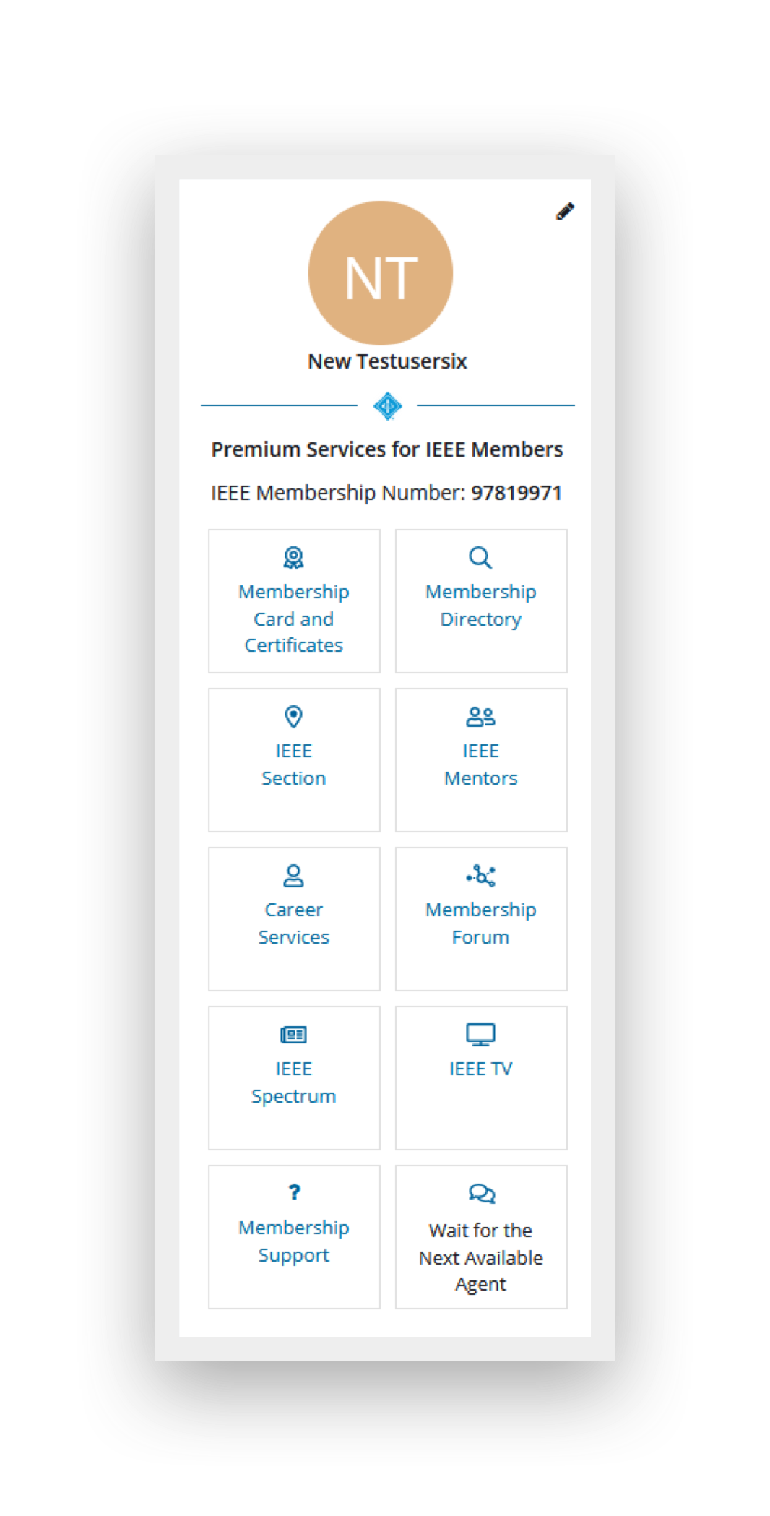






Premium Experience (IEEE Members Only)
The Home Stream Console provides one-click access to Member services:
IEEE Membership Certificates, Cards, Badges
IEEE Membership Directory
IEEE Section & Student Branch Gateways
IEEE Mentors
IEEE Career Services
IEEE Spectrum, IEEE.tv
Non-Member experience grays out links to Member services, with link to join application.

Slide 16
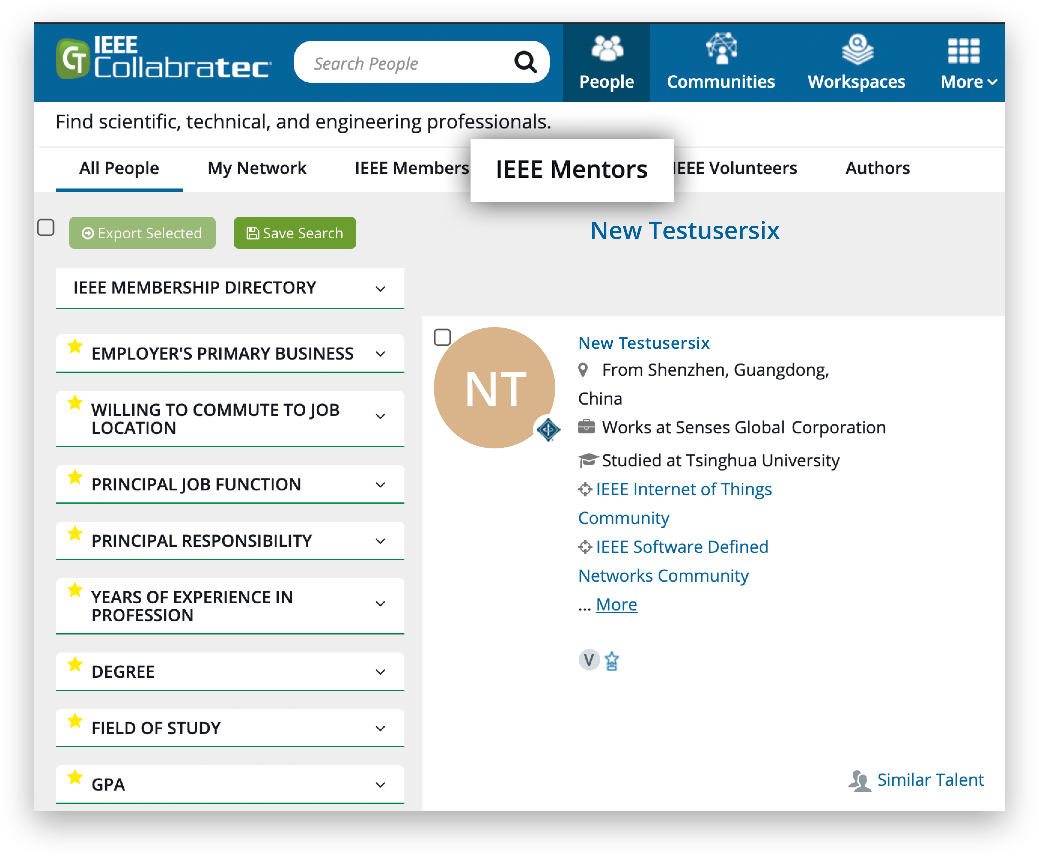
Mentor Program
Collabratec facilitates Mentor and Mentee partnerships.
Mentees
Career services education and training from IEEE professionals
The ‘network’ feature offers two options - initiate a mentor request, or to simply connect
Private workspaces for mentor/mentee collaboration
Mentors
Mentor activation from the preferences area, careers suite - identified with mentor badge
Preferences for mentoring partnership can be personalized

Slide 17


Key Words
Umbrella Message: Discover, Connect, Collaborate, Membership, Community, One suite/hub
Members: Connect, Recognition, Access, Community, Belong, Membership, Join, Network
Volunteers: Volunteer, Get things done, Engage, Find volunteering opportunities, Reach out
Authors/Researchers: Easier workplace, Teamwork, Assist productivity, Collaboration, Connection
Institutional Customers/academia: Collaboration, Global, Connection, Teamwork, Communication, Mentor, Teach
Institutional Customers/corporate: Collaboration, Global, Connection, Teamwork, Communication, Leadership, Influence
Technical Activities: Your community, build and manage professional network, Share, See what’s new, Reach out, Influence the conversation

Slide 18

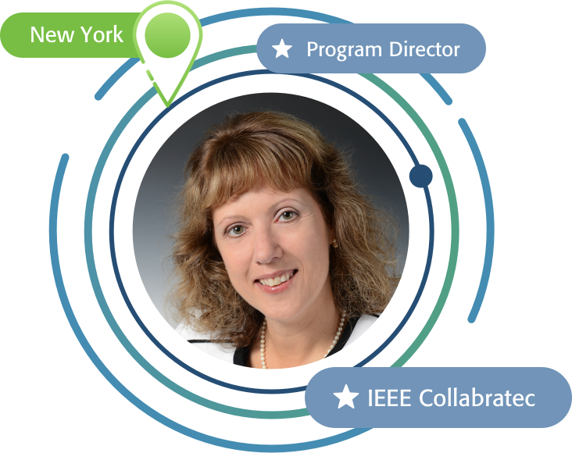
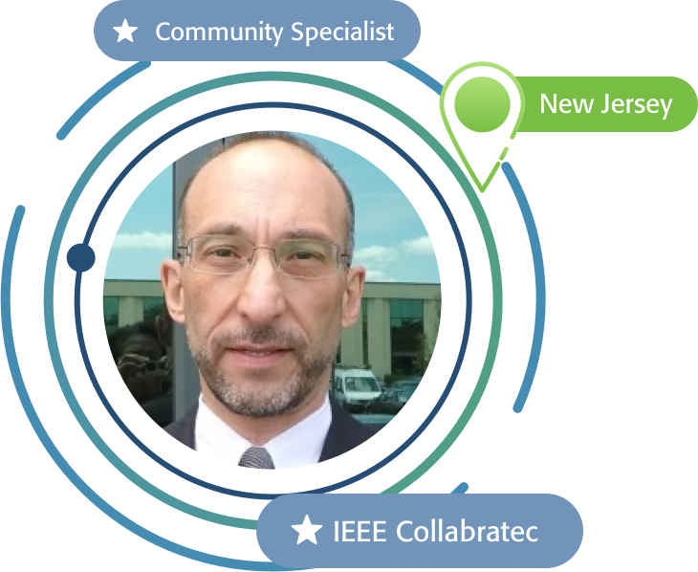
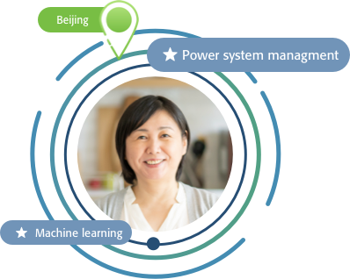
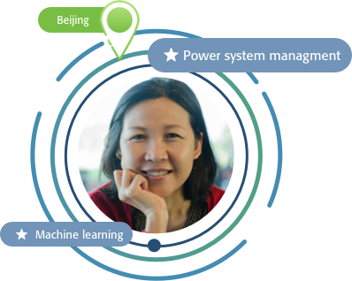

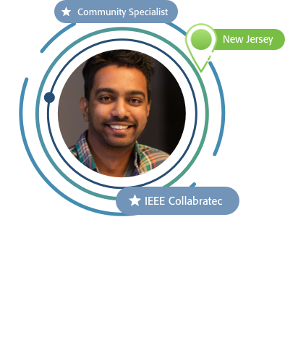
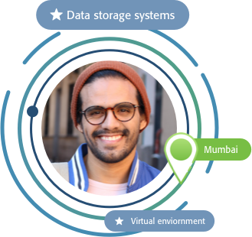
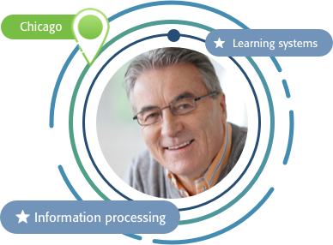
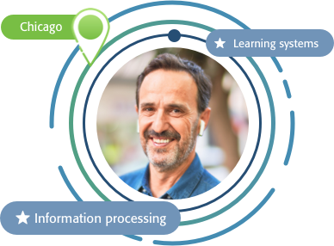
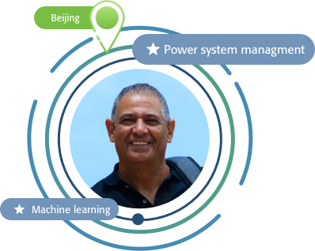
Additional Support
Extraordinary Team of IEEE Collabratec Ambassadors & Staff Support
Natalie Apadula
Linda Uslaner
Victor Manganaro
Several Volunteer Ambassadors from across the globe!
n.apadula@ieee.org
l.uslaner@ieee.org
v.manganaro@ieee.org
For additional support, please visit:
https:// sites.google.com/a/ieee.org/ieee-collabratec/

Slide 19
19

